Slide 1
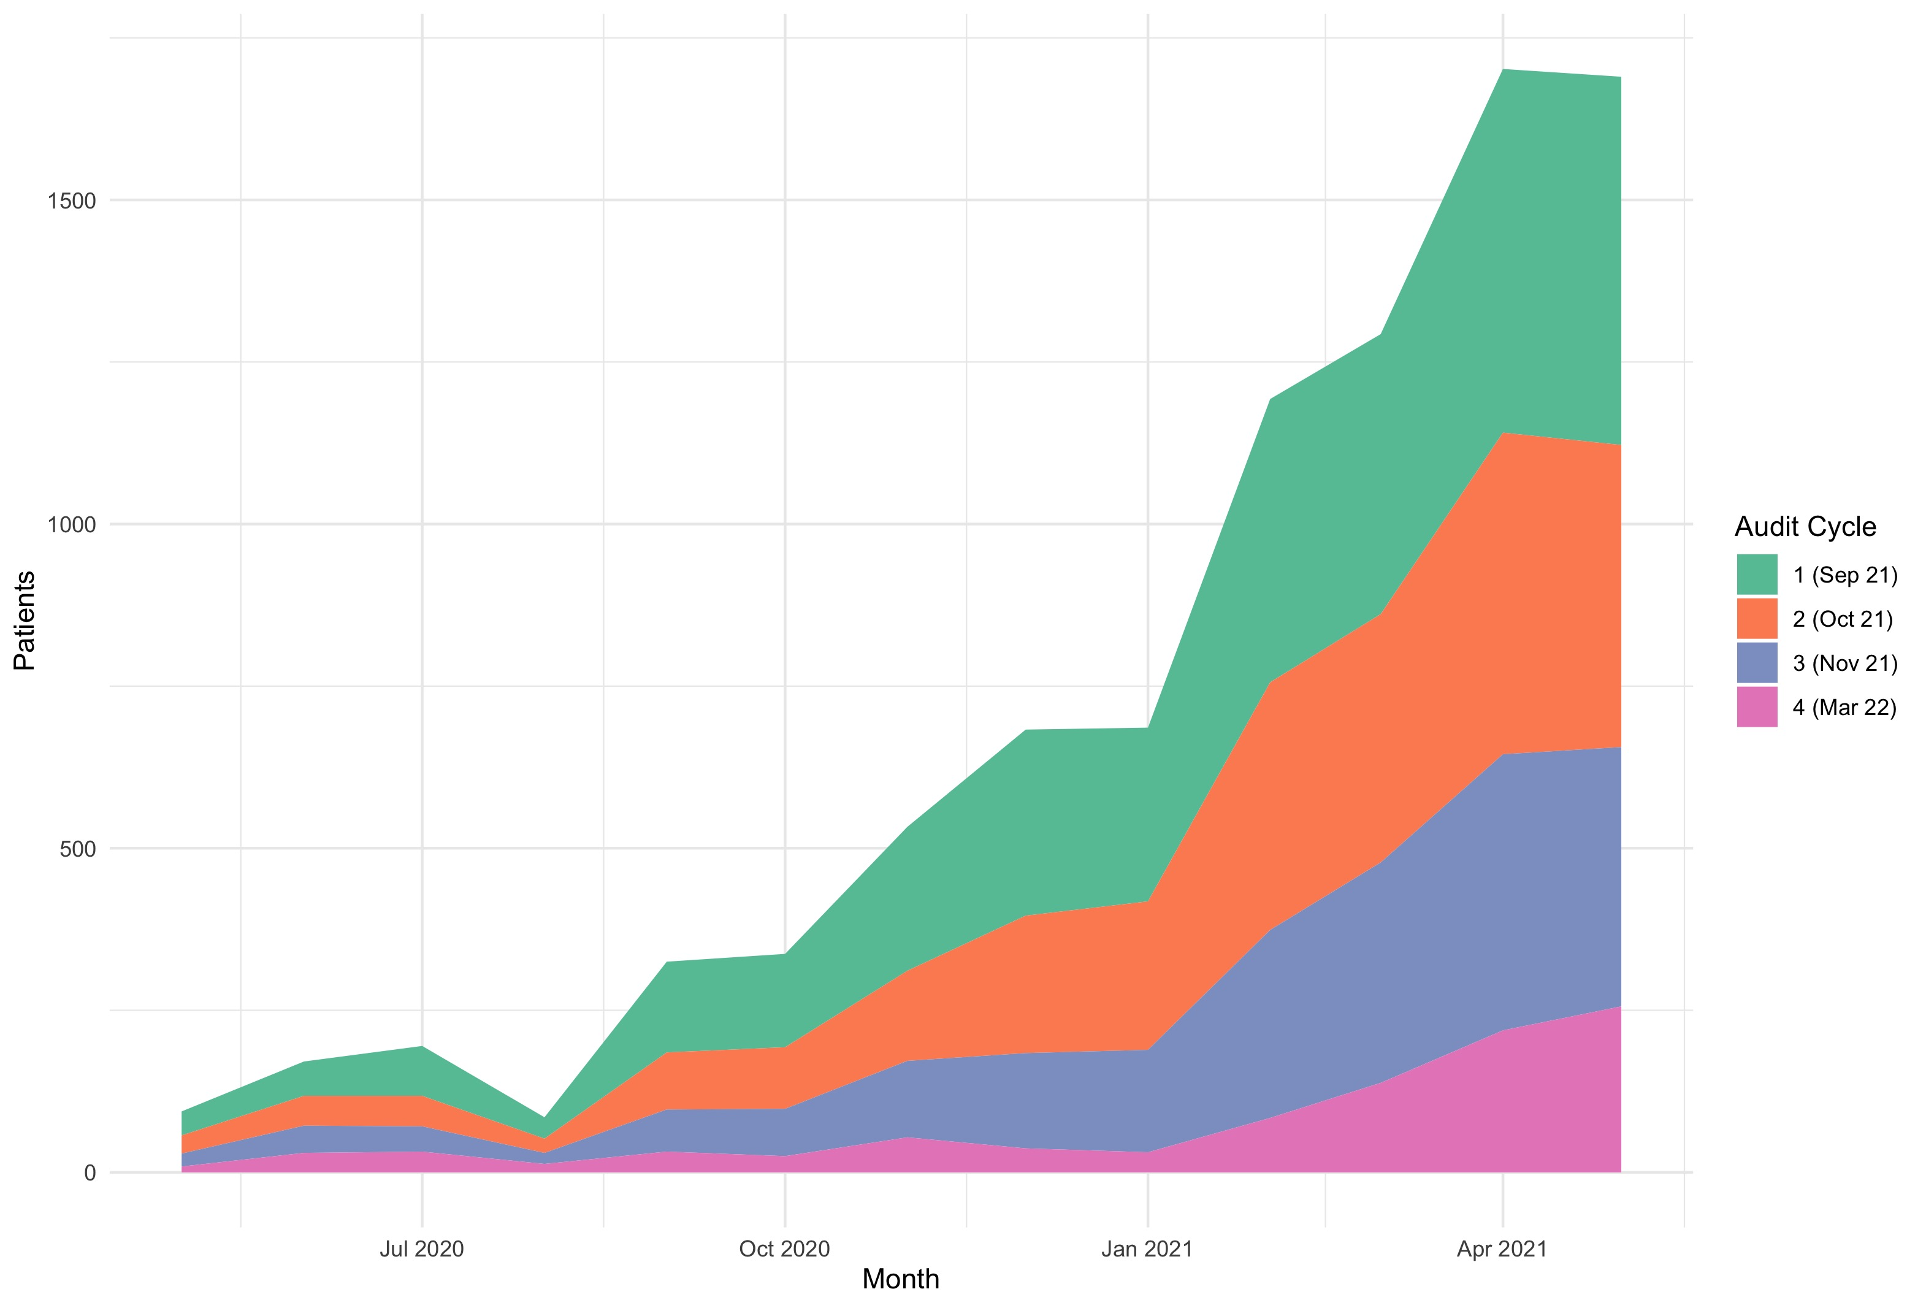
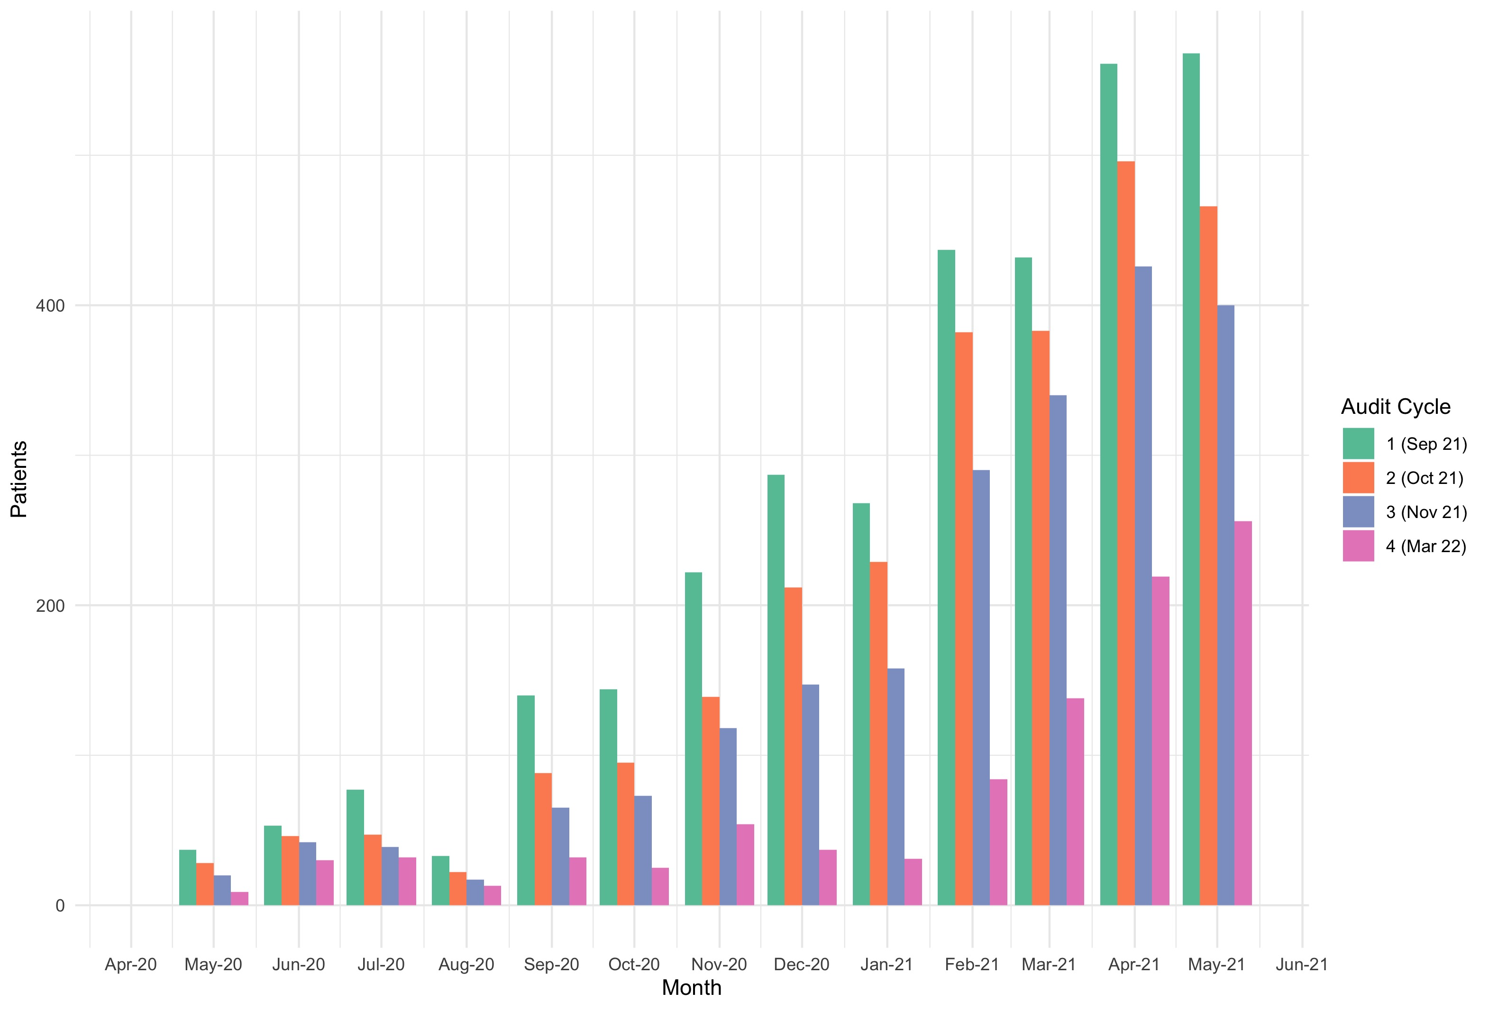
Analysis of the outpatient Rheumatology Backlog
May 20202 -May 2021
Change in the number of patients on the backlog per month

Slide 2
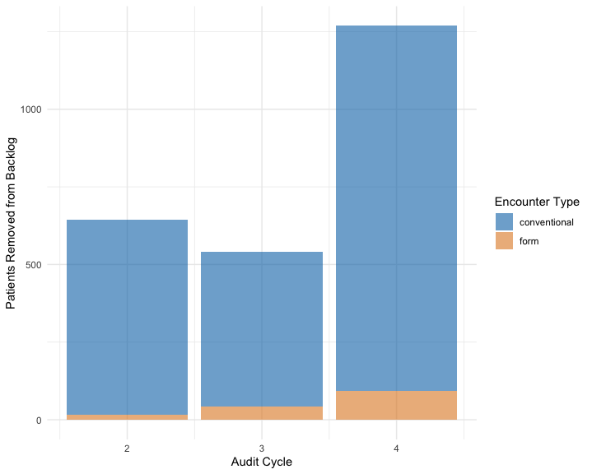
The use of electronic Remote Management Forms to shift patients from the Rheumatology Backlog
May 20202 -May 2021
Remote Management Form responses collated in database n = 1956
Removing forms without a “previous appointment” date n = 261
Selecting patients with their previous appointment within the Backlog period of interest (May 20 – May 21)
n = 154
Filtered for forms submitted during out audit (after 17 Sep 2021) n = 745
Use of Remote Management Forms in the Backlog
Audit Cycle | Cycle Date | Backlog Total | Patients shifted from Backlog | No. forms completed (%)
1 | Sep 2021 | 3259 | NA | NA
2 | Oct 2021 | 2633 | 626 | 17 (2.72)
3 | Nov 2021 | 2135 | 498 | 43 (8.63)
4 | Mar 2022 | 960 | 1175 | 94 (8.00)
n = number of forms suitable for analysis
Discussion
These results likely indicate an under-estimate, given the amount of incomplete data (largely limited by patients not knowing when exactly their last appointment date was. The data presented here demonstrates an increase in the percentage of patients shifted from the backlog by remote management form over the 6 months of this audit cycle to approximately 8%.
It should be noted that the period covered in Audit Cycle 4 is 4 months (compared to 1 month for the previous cycles).
It may be possible using the Rheumatology database and the Electronic Patient Record to ‘complete’ the remote management data with patient appointment dates and derive a more accurate estimation of the share of Backlog patients reviewed by electronic form compared to conventional consultations.

